Slide 1
2020 GU 口試共筆
撰：北醫 劉正昇
校：中國醫 林亭君

Slide 2
三總 林群書 (Bladder)

Slide 3
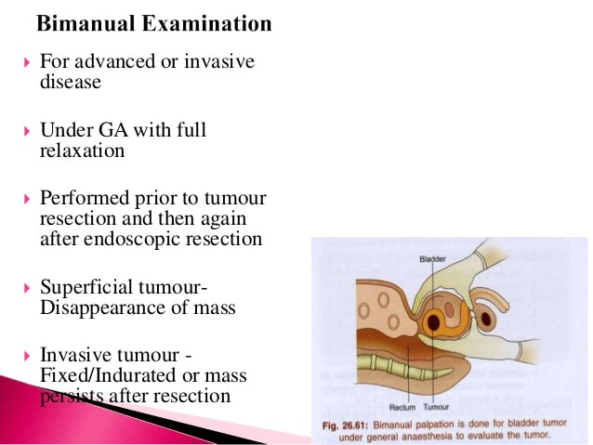
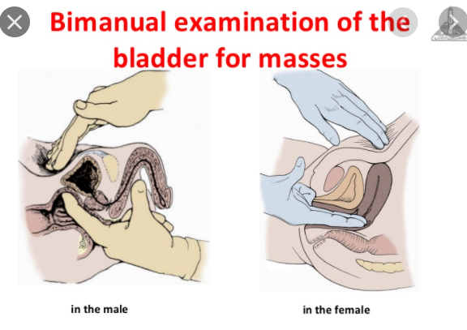
TURBT with bimanual exam under anesthesia 請問什麼是 bimanual exam under anesthesia ？

Slide 4
TURBT papillary腫瘤侵犯黏膜層, 但是TURBT的病理中沒有肌肉層，請問stage、接下來給什麼治療？
NCCN guildeline 2021 v.4
侵犯黏膜層
Consider repeat TURBT for high-grade Ta particularly if large, and/or no muscle in specimen
Muscle may be moitted in cases of documented low-grade Ta disease
🡪 沒切到肌肉層為 inadequate TURBT 🡪 Re-TURBT

Slide 5
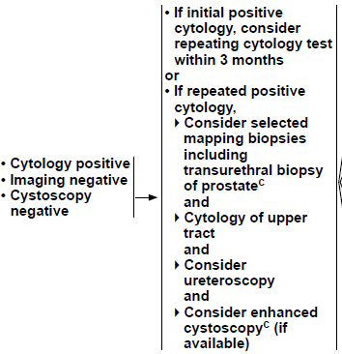
治療過後cytology (+) cystoscope (-) (image negative, 含CTU/MRU) 請問下一步？
侵犯黏膜層，期別至少為 T1
NCCN guildeline 2021 v.4
考慮三個月後再追蹤 cytology；若仍 positive考慮：
Mapping biopsies (including transurethral biopsy of prostate)
Cytology of upper tract
Ureteroscopy
Enhanced (blue light and narrow-band imaging) cystoscopy

Slide 6
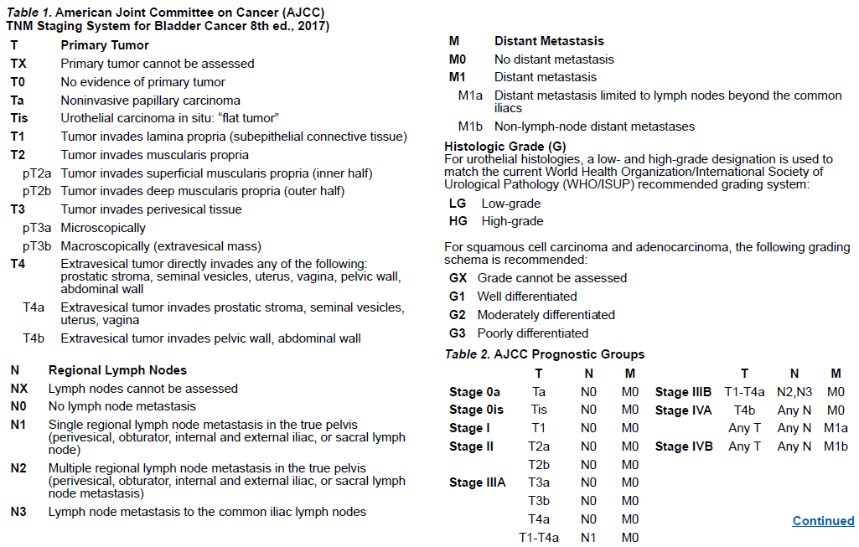
病人TURBT腫瘤侵犯肌肉深層, 兩顆淋巴結包含common iliac mets, 請問 stage？
AJCC 8th
Deep muscularis propria: T2b
Common iliac LN: N3
N2,N3 = stage IIIB
T2bN3M0 (若無遠端轉移), stage IIIB

Slide 7
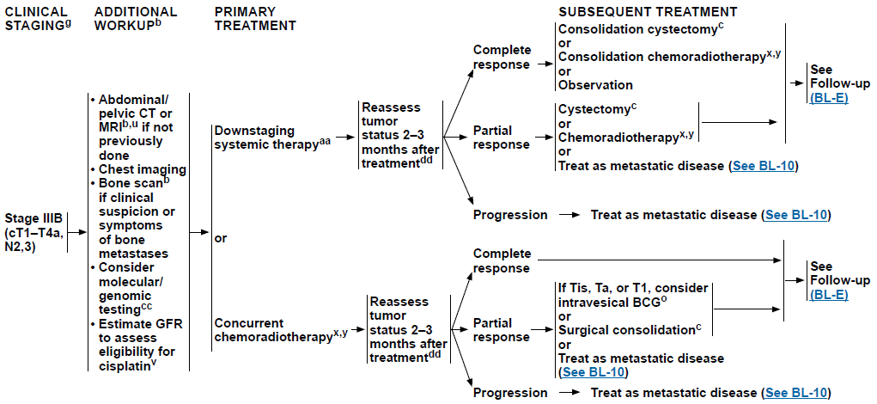
怎麼治療, 化療給什麼？
NCCN guildeline 2021 v.4
給予 Downstaging systemic therapy 或 直接 CCRT，兩到三個月後 tumor reassessment
Downstaging systemic therapy 使用 DDMVAC 或是 Cisplatin + Gemcitabine
CCRT
RT
Whole bladder + pelvic LN 做 39.6-50.4Gy
Whole bladder 或 partial bladder 及 involved LN 做到 60-66 Gy
C/T: cisplatin/5FU, cisplatin/paclitaxel, 5-FU/mitomycin, cisplatin (doublet C/T preferred)

Slide 8
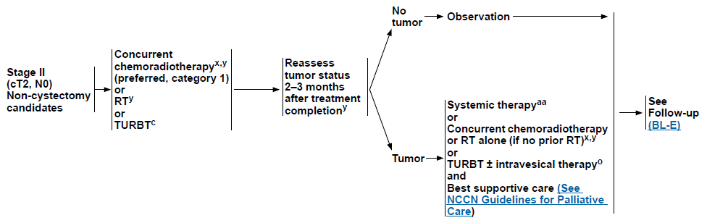
8X歲病人cT2N0 bladder cancer,不能開刀, 請問bladder preservation你怎麼做
NCCN guildine 2021 v.4
Bladder preservation 需要先做 maximal TURBT
CCRT (preferred)
RT
Whole bladder + pelvic LN 做 39.6-50.4Gy
Whole bladder 或 partial bladder 及 involved LN 做到 60-66 Gy
C/T: cisplatin/5FU, cisplatin/paclitaxel, 5-FU/mitomycin, cisplatin (doublet C/T preferred)
RT
TURBT

Slide 9
Simulation 的時候怎麼做，治療時是 empty bladder 還是 full bladder
Patient supine with immobilization device (alpha cradle, vacuum-lock bags)
Empty bladder
Tumor boost phase 可以考慮 full bladder with image guidance
CT scan (preferably with contrast) from 3 cm above L5 to inferior of ischial tuberosity (at least)
Consulting bladder map from TURBT for planning
附註：Green Journal 曾有研究指出 bladder wall motion 在 full bladder or empty bladder 並無差異，兩種作法其實都可以；可回答應依病人個別情形決定是否脹尿，例如配合度低、尿失禁的年老病人，可以 empty bladder就好。Ref: https://pubmed.ncbi.nlm.nih.gov/25483834/

Slide 10
高榮 劉文山 (Prostate)

Slide 11
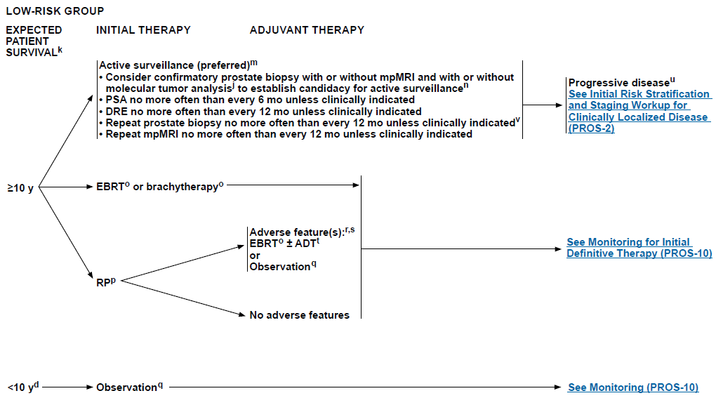
Prostate low risk 病人, 68歲 [餘命>20], 請解釋治療選項及好處壞處 (要特別注意Active surveillance和介入處置的優缺點及其evidence)
Low-risk group 餘命大於十年的治療方式包含：
Active surveillance (preferred)
EBRT or brachytherapy
RP

Slide 12
PortecT (clinical outcome), Hamdy et al., NEJM, 2016
AS vs. Surgery vs. RT
Primary outcome: prostate-cancer specific mortality (PCSM) at 10 years
🡪 PCSM 無差異
Treatment | N | PCSM (/1000 person-year) | Incidence of clinical progression (/1000 person-year) | Incidence of metastatic disease (/1000 person-year) | All-cause mortality (/1000 person-year)
AS | 545 | 1.5 | 22.9 | 6.3 | 10.9
Surgery | 553 | 0.9 | 8.9 | 2.4 | 10.1
RT | 545 | 0.7 | 9.0 | 3.0 | 10.3
P-value |  | 0.48 | <0.001 | 0.004 | 0.87

Slide 13
PortecT (patient reported outcome), Donovan et al., NEJM, 2016
比較AS, Surgery, RT 對於病患泌尿道、腸胃道、性功能的影響
Surgery
影響尿失禁及性功能，六個月達最嚴重較另外兩組差，且持續到試驗結束(五年)
RT
影響腸胃道及性功能，六個月達最嚴重，後來慢慢恢復 (血便除外)
AS
泌尿道及性功能慢慢下降

Slide 14
PSA的高低和預後的關係 以及 PSA還有哪些要注意(density, doubling time, 受年齡影響等等)
NCCN guideline 2021 v.2; handbook of evidence-based radiation oncology 3/e
PSA < 10 ng/ml 🡪 very low or low risk group 🡪 5-10 year BFS: 75-90%
PSA 10-20 ng/ml 🡪 intermediate risk group 🡪 5-10 year BFS: 50-85%
PSA > 20 ng/ml 🡪 high or very high risk group 🡪 5-10 year BFS: 20-60%
Radiation oncology 3/e A question-based review
PSA as a function of age
40-49 years: 1.5-2.5 ng/ml
50-59 years: 2.5-4 ng/ml
60-69 years: 4-5.5 ng/ml
70-79 years: 5.5-7 ng/ml
PSA velocity (PSAV)
PSAV >= 2ng/ml/yr 🡪 assicaited with a higher risk of finging GS >=7 prostate cancer on prostatectomy
PSA density (PSAD)
PSAD of >= 0.15 ng/ml/cm3 🡪 higher risk of detecting prostate cancer on screening biopsy
Ratio of free to total PSA
< 7% 🡪 highly suspicious of prostate cancer
>25% 🡪 rarely associated with malignancy

Slide 15
Prostate high risk 病人, 病人打 ADT 之後問 RT 可不可以延後做, cue 你講出evidence (SPCG-7)
SPCG-7
875 patients, cT1b-T2N0, WHO Gr.2-3 or cT3N0, any grade
Total androgen blockade 3 months 🡪 flutamide vs. RT (70Gy) + flutamide
10-year OS: 70% vs. 61% and 10-year CSS: 88% vs. 76% (favor RT arm)

Slide 16
ADT為什麼要用 2-3年 (也會問可不可以不要打hormone)
RTOG 9202 比較 4 個月即 28 個月的 ADT
1541 pts cT2c-T4, PSA < 150
Neoadjuvant + Concurrent ADT 4 個月 +/- 2 年 ADT (RT: 65-70Gy)
28 個月的 ADT 有較好的 10 年 CSS (89% vs. 84%), 局部復發 (12% vs. 22%) 及遠端轉移 (15% vs. 23%)
Subgroup analysis 發現 28 個月 ADT 在 GS >=8 族群可延長 10 年 OS
EORTC 22961 比較 6 個月即 36 個月的 ADT
收錄 1113 位 cT2c-T4N0 或 cT1c-T2bpN1-N2
RT (70Gy) + 6 or 36 months ADT (neoadjuvant, concurrent, adjuvant)
36 個月 ADT 有較好 5 年 OS (85% vs. 81%) 及 CSM (3.2% vs. 4.7%)
EORTC 22863 比較 有沒有使用 ADT
收錄 412 位 cT3-T4 any grade 或 cT1-T2 Gr.3
EBRT (70Gy) +/- 3 年 ADT
3 年 ADT 有較好的 5 年 OS (78% vs. 62%), CSS (94% vs. 79%), LF (1.7% vs. 16.4%) 及 distant failure (9.8% vs. 29.2%)

Slide 17
Prostate cancer, s/p OP, 什麼時候考慮做 adjuvant RT, adjuvant的定義
NCCN guideline 2021 v.2
Adjuvant RT indication: positive margin(s), seminal vesicle invasion, extracapsular extension, or detectable PSA
Adjuvant and Salvage Radiotherapy after Prostatectomy: ASTRO/AUA Guideline (2013, amended 2018 & 2019)
Adjuvant RT is defined as the administration of RT to post-RP patients at a higher risk of recurrence because of adverse pathological features prior to evidence of disease recurrence (i.e., with an undetectable PSA).

Slide 18

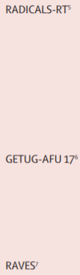
Salvage RT什麼時候做, 多早算early salvage，術後PSA0.2以上考慮做salvage，病人想等最好不要超過多少?0.5
NCCN guideline 2021 v.2
Indications of salvage RT
Undetectable PSA that becomes subsequent detectable and increases on 2 measurements
PSA that remains persistently detectable after RP
Early salvage RT
早期研究多定義為 <= 0.5 ng/ml (1)
近期研究多定義為 <= 0.2 ng/ml (2)(包含三篇 RCT 探討 adjuvant vs. salvage RT)
Radiation oncology 3/e A question-based review
PSA < 0.5 ng/ml
PSA < 0.5 ng/ml associated with lower rates of distant metastases, cancer specific death, and all-cause mortality
Briganti A, Wiegel T, Joniau S et al: Early salvage radiation therapy does not compromise cancer control in patients with pT3N0 prostate cancer after radical prostatectomy: results of a match-controlled multi-institutional analysis. Eur Urol 2012; 62: 472.
Tendulkar RD, Agrawal S, Gao T, et al. Contemporary update of a multi-institutional predictive nomogram for salvage radiotherapy after radical prostatectomy. J Clin Oncol 2016; 34: 3648–54.

Slide 19
什麼是 PSA bounce
Radiation oncology 3/e A question-based review
接受放射治療後 PSA 短暫上升，通常發生在治療後 12-18 個月以及接受 brachytherapy

Slide 20
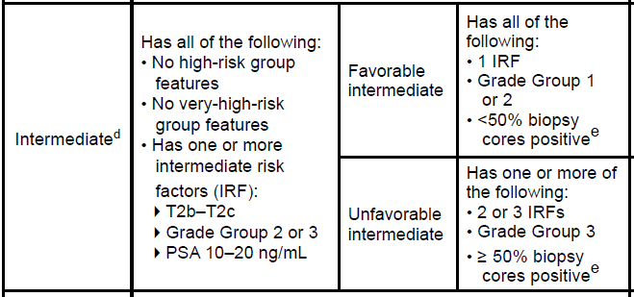
Intermediate risk group，favorable/unfavorable的定義
NCCN guideline 2021 v.2

Slide 21
何謂 Dose escalation
Radiation oncology 3/e A question-based review
四篇 RCT 探討 dose escalation (>= 74Gy) 的影響
Study | Patient | N | RT dose (Gy) | Outcome | Result
MADCC | cT1b-T3 (21% LR, 47% IR, 32% HR) | 301 | 78 vs. 70 | 8-yr FFF 8-yr CSS (NS) 8-yr OS (NS) | 78% vs. 59% (LR & HR) 99% vs. 95% 78% vs. 79%
PROG 9505 | T1b-T2b, PSA < 15 ng/mL | 393 | 79.2 vs. 70.2 | 5-yr bFFBF 5-yr LC | 80% vs. 61% 68% vs. 48%
Dutch | T1b-T4 | 664 | 78 vs. 68 | 10-yr FFBF | 49% vs. 43%
MRC RT01 | cT1b-T3a, PSA < 50 | 843 | 74 vs. 64 | 5-yr bPFS | 71% vs. 60%

Slide 22
Intermediate risk 的病人 dose escalation 還要給 hormone 嗎
EORTC 22991
819 patients (74.8% IR, 24.8% HR)
RT (70, 74, 78Gy) +/- ADT (6 months)
ADT improved biochemical failure (HR: 0.53) and clinical failure (HR: 0.63)
PSC III
600 patients (IR)
RT 70Gy + ADT vs. RT 76Gy + ADT vs. RT 76Gy
Higher rate of biochemical failure, higher rates of prostate cancer progression, and more deaths due to prostate cancer for RT 76Gy compared to RT 70Gy + ADT and RT 76Gy + ADT

Slide 23
Intermediate risk 的病人 brachy boost 有什麼好處
Radiation oncology 3/e A question-based review
RTOG 0232 (await full paper)
Less benefit of brachytherapy boost for favorable IR
Hoskin PJ et al.
218 patients, IR/HR
55Gy/20Fx vs. 35.75Gy/13Fx + HDR (17Gy/2Fx)
31% reduced risk of recurrence
ASCENDE-RT
398 patients, IR/HR patients
WPRT 46Gy + EBRT boost to 78Gy vs. LDR boost to 115Gy
50% risk of biochemical failure in the LDR boost arm

Slide 24
High risk 的病人 brachy boost 有什麼好處
Hoskin PJ et al.
IR/HR patients
55Gy/20Fx vs. 35.75Gy/13Fx + HDR (17Gy/2Fx)
31% reduced risk of recurrence
ASCENDE-RT
IR/HR patients
WPRT 46Gy + EBRT boost to 78Gy vs. LDR boost to 115Gy
50% risk of biochemical failure in the LDR boost arm

Slide 25
Brachy 的主要好處?
NCCN guideline 2021 v.2
Treatment completed in 1 day with little time lost from normal activities
Cancer control rates comparable to radical prostectomy (>90%) for low-risk prostate cancer
Risk of incontinence is minimal without TURP
Erectile function preserved in the short term
Rapid dose falloff 🡪 limit dose to adjacent OAR 🡪 decreased treatment related toxicities
Less associated with secondary malignancy (1)
1. Abdel-Wahab M., Reis I.M., Hamilton K. (2008) Second primary cancer after radiotherapy for prostate cancer -a SEER analysis of brachytherapy versus external beam radiotherapy. Int J Radiat Oncol Biol Phys 72: 58–68

